Slide 1

Hiring Process Analysis using Excel
BY: Sangeeta kolkar

Slide 2
Description:
Hiring process is the fundamental and the most important function of a company. Here, the MNCs get to know about the major underlying trends about the hiring process. Trends such as- number of rejections, number of interviews, types of jobs, vacancies etc. are important for a company to analyse before hiring freshers or any other individual. Thus, making an opportunity for a Data Analyst job here too! Being a Data Analyst, your job is to go through these trends and draw insights out of it for hiring department to work upon. You are working for a MNC such as Google as a lead Data Analyst and the company has provided with the data records of their previous hirings and have asked you to answer certain questions making sense out of that data.

Slide 3
Questions to be answered:
Hiring: Process of intaking of people into an organization for different kinds of positions. Your task: How many males and females are Hired ?
Average Salary: Adding all the salaries for a select group of employees and then dividing the sum by the number of employees in the group. Your task: What is the average salary offered in this company ?
Class Intervals: The class interval is the difference between the upper class limit and the lower class limit. Your task: Draw the class intervals for salary in the company ?
Charts and Plots: This is one of the most important part of analysis to visualize the data. Your task: Draw Pie Chart / Bar Graph ( or any other graph ) to show proportion of people working different department ?
Charts: Use different charts and graphs to perform the task representing the data. Your task: Represent different post tiers using chart/graph?

Slide 4
Steps taken to prepare the data for analysis:
Firstly, I made a copy of the raw data to perform the analysis so that the original data is not affected.
Changed the data types of columns to correct types.
Renamed some columns for better understanding.
Made sure that the application_id column has no duplicate values.
Checked for null values and replaced it with the median value.
Checked for outliers and removed them for optimized analysis.
Checked for spelling mistakes.
Used Pivot Table , Charts for summarizing the data and visualizing the data respectively.

Slide 5
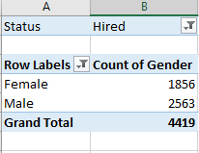
Task A: How many males and females are Hired ?
I have used Pivot Table to find the number of males and females hired.
The total number of females hired is 1856.
The total number of males hired is 2563.

Slide 6
Task B: What is the average salary offered in this company ?
Firstly I have calculated the IQR (Interquartile Range) using 1st Quartile and 3rd Quartile and then calculated the upper and lower bound.
Then I have used IF, OR statements to find the outliers from Salary column and removed them.
I have then calculated the average salary using the average formula.
The average salary offered in the company is 49983.02

Slide 7
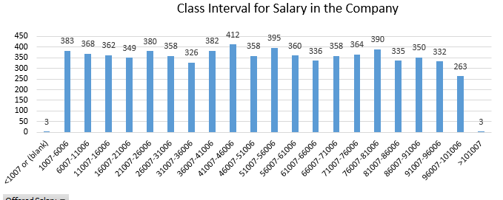
Task C: Draw the class intervals for salary in the company ?
Used Pivot Table to summarize the salary and number of posts.
Then I have grouped salary using group option with starting point being 1000 and ending point being 100000 by interval of 5000.
Used the Column chart to represent the results.
From the chart we can see that the highest number of posts is 412 for the salary range of 41007-46006.

Slide 8
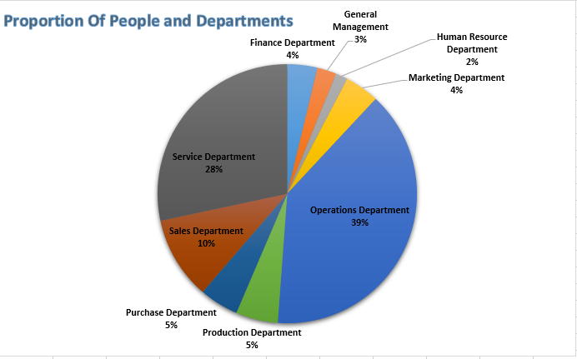
Task D: Draw Pie Chart / Bar Graph ( or any other graph ) to show proportion of people working different department ?
Used Pivot Table to summarize the data and Pie Chart to show the proportion of people working in different departments. Operations Dept. has the highest number of people working in it.

Slide 9
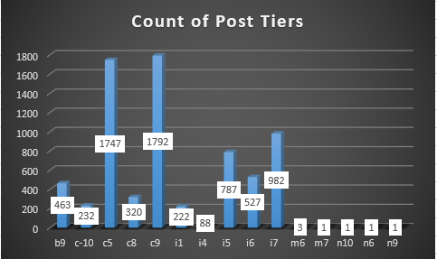
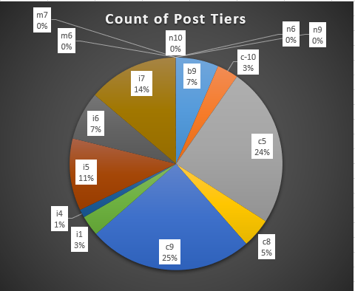
Task E: Represent different post tiers using chart/graph?

Slide 10
Analysis:
There is much difference in total no of females and males hired due to the fact that since the Company is an MNC and men-women equality has not yet reached to every part of the world.
The highest number of posts is 412 for the salary range of 41007-46006.
The no of people with salary greater than 100000 are only 3, such people are specialist with high years of experience and expertise and hence the company offers them high salary to retain them.
The Operations Department has highest number of people working because operations team plays major role and all execution tasks have been handled by this department , it has more workload and hence more no of people are there in this department.

Slide 11
Thank You.

